Slide 1

Java Annotations
Notes:
Just into on why we’re here today and what’s the point of having this presentation. Brifely touch the topic of presenters: SZ, OZ, IL, and KK.
In the end: passing the floot to Sviatlana.

Slide 2
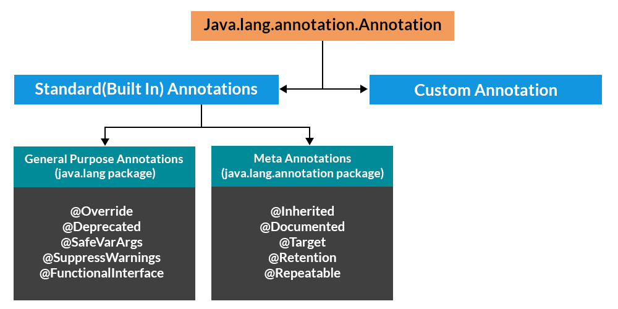
Hierarchy of Annotations in Java

Slide 3
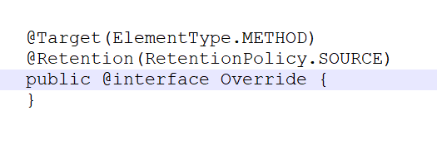
@Override
Indicates that a method declaration is intended to override a method declaration in a supertype. If a method is annotated with
this annotation type compilers are required to generate an error message unless at least one of the following conditions hold:
1)The method does override or implement a method declared in a
supertype.
2) The method has a signature that is override-equivalent to that of
any public method declared in Object.
So, if we’re implementing some interface, we should add method implementations marked with @Override

Slide 4
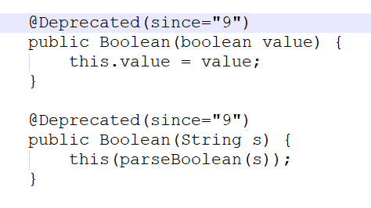
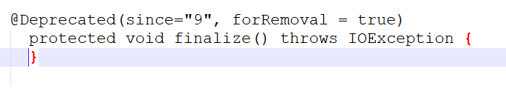
@Deprecated
@Deprecated annotation is used for marking
API as not intented for use anymore.
Additionally, since Java 9 original implementation has got two additional fields:
since and forRemoval.
We can see that method finalize() in FileInputStream class is marked forRemoval

Slide 5
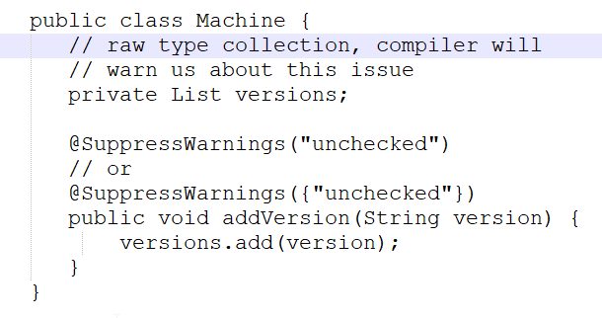
@SuppressWarnings
Although compiler warnings are useful because they can tell us that we have code with bad smell, sometimes we may want to violate these rules by purpose in case of production needs.

Slide 6
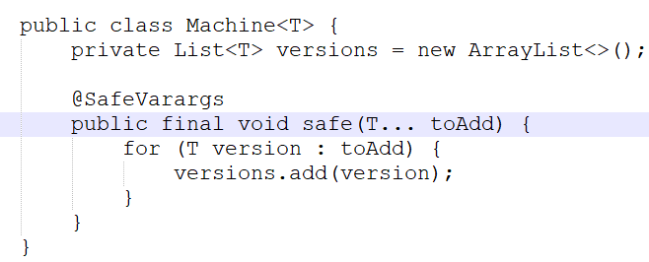
@SafeVarArgs

Slide 7
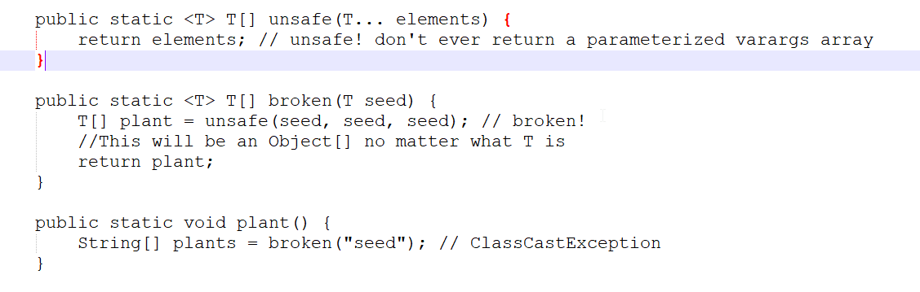
@SafeVarArgs

Slide 8
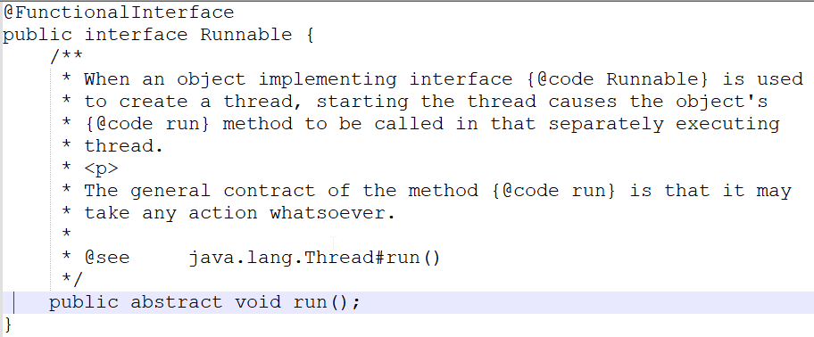
@FunctionalInterface
One of the most obvious
examples of @FunctionalInterface is
Runnable.

Slide 9
Hierarchy of Annotations in Java

Slide 10

@Target
Describes the targets to which an annotation can be applied
Takes ElementType enumeration as its only argument:
ANNOTATION_TYPE - Annotation type declaration
CONSTRUCTOR - Constructor declaration
FIELD - Field declaration (includes enum constants)
LOCAL_VARIABLE - Local variable declaration
METHOD - Method declaration
PACKAGE - Package declaration
PARAMETER - Formal parameter declaration
TYPE - Class, interface (including annotation type), or enum declaration
TYPE_PARAMETER - Type parameter declaration
TYPE_USE - Use of a type
@Target annotation is a meta-annotation, it can be used to annotate other annotations.

Slide 11
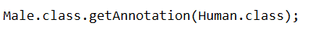
@Retention
Describes how long the annotation should be retained by the compiler
Takes RetentionPolicy enumeration as its only argument:
RetentionPolicy.SOURCE: annotations discarded at runtime.
RetentionPolicy.CLASS: annotations recorded in the .class file but are discarded during runtime. CLASS is the default retention policy in Java.
RetentionPolicy.RUNTIME: annotations retained during runtime and can be accessed in program during runtime.
@Retention annotation is a meta-annotation, it can be used to annotate other annotations.

Slide 12
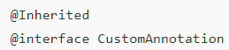
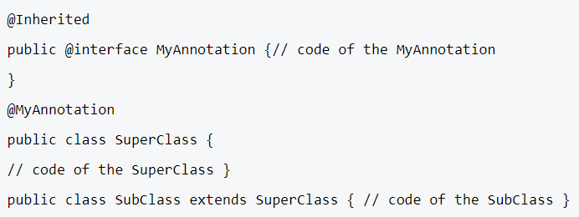
@Inherited
Denotes that an annotation should be inherited by a subtype if applied to a supertype
Does not take any arguments.
@Inherited annotation is a meta-annotation, it can be used to annotate other annotations.

Slide 13
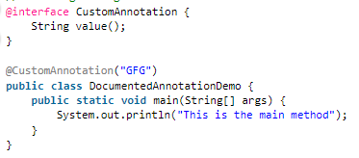
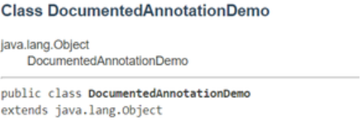
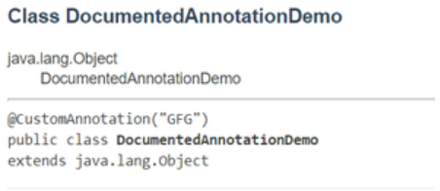
@Documented
Used to ensure that our custom annotations are shown in the documentation
Does not take any arguments.
Raw:
Marked @Documented:
@Documented annotation is a meta-annotation, it can be used to annotate other annotations.

Slide 14
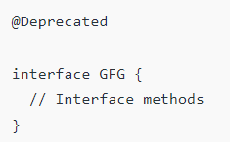
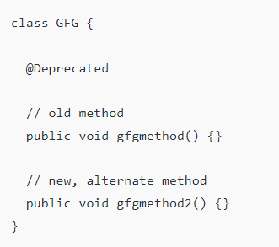
@Deprecated
Denotes that an annotation (or any other type) should no longer be used
Does not take any arguments.
Instead of breaking the backward compatibility of the project's API, we can tag these elements with the @Deprecated annotation.
What can be marked as @Deprecated
Interface
Class
Method
Member variable
Constructor
@Deprecated annotation is a meta-annotation, it can be used to annotate other annotations.

Slide 15

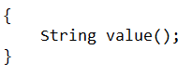
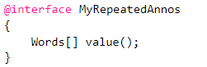
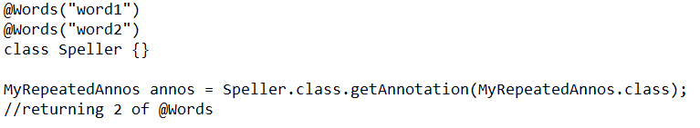
@Repeatable
Denotes that an annotation can be applied multiple times in the same context
Takes CLASS as its only argument
@Repeatable annotation is a meta-annotation, it can be used to annotate other annotations.

Slide 16
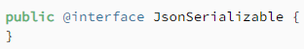
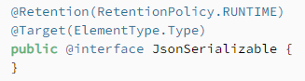
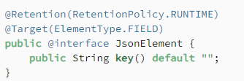
Creating a custom annotation
1) Declare it using the @interface keyword
2) Add meta-annotations (if required)
3) Add annotation fields (if required)

Slide 17
Possible question:
How to create a custom meta-annotation?

Slide 18
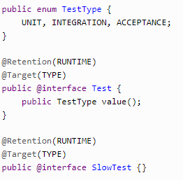
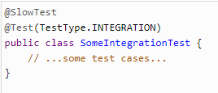
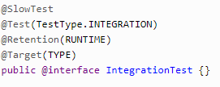
Creating a custom meta-annotation
Annotation that has a target that includes ElementType.TYPE or ElementType.ANNOTATION_TYPE

Slide 19
Custom annotations from popular frameworks
Annotation | Library | @Target
@Component | Spring | ElementType.TYPE
@Autowired | Spring | ElementType.CONSTRUCTOR, ElementType.METHOD, ElementType.PARAMETER, ElementType.FIELD, ElementType.ANNOTATION_TYPE
@GetMapping | Spring | ElementType.METHOD
@Controller | Spring | ElementType.TYPE
@Slf4j | Lombok | ElementType.TYPE
@Getter | Lombok | ElementType.FIELD, ElementType.TYPE
@AllArgsConstructor | Lombok | ElementType.TYPE

Slide 20


